Slide 1
Bioinformatics and Health Technology Lecture 1: Data Structures for Bioinformatics Primer
William Okech, PhD (Instructor)
2025

Slide 2
Outline
Class Logistics
Introduction to Biological Data
Overview of Data Structures
Applications of Data Structures in Bioinformatics
Summary

Slide 3

Outline
Class Logistics
Introduction to Biological Data
Overview of Data Structures
Applications of Data Structures in Bioinformatics
Summary

Slide 4
Class Policies
Expectations: To ensure a safe learning environment please treat each other with respect.
Attendance: Course is run using an in-person format and attendance is mandatory unless explicit permission is obtained from the instructor.
Assignments: Late homework and lab reports will not be accepted unless extensions have been requested in advance.

Slide 5
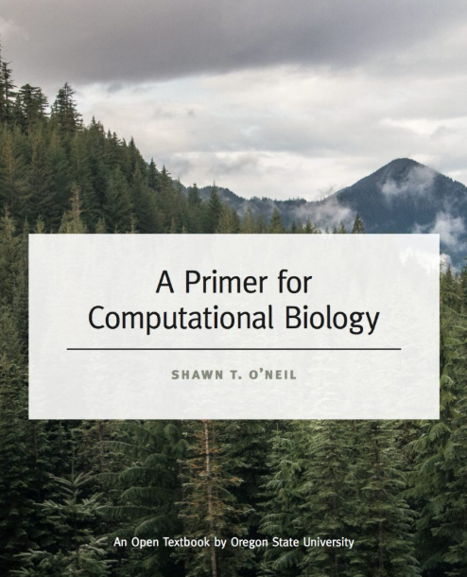
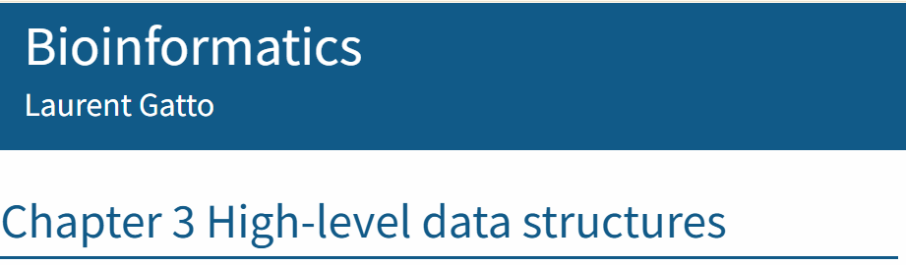
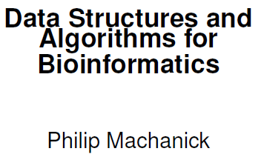
Reference Textbooks
https://uclouvain-cbio.github.io/WSBIM1322/sec-obj.html
Chapter 25: Algorithms and Data Structures
https://open.oregonstate.education/computationalbiology/

Slide 6

Outline
Class Logistics
Introduction to Biological Data
Overview of Data Structures
Applications of Data Structures in Bioinformatics
Summary

Slide 7











Biological Data is Everywhere!

Slide 8
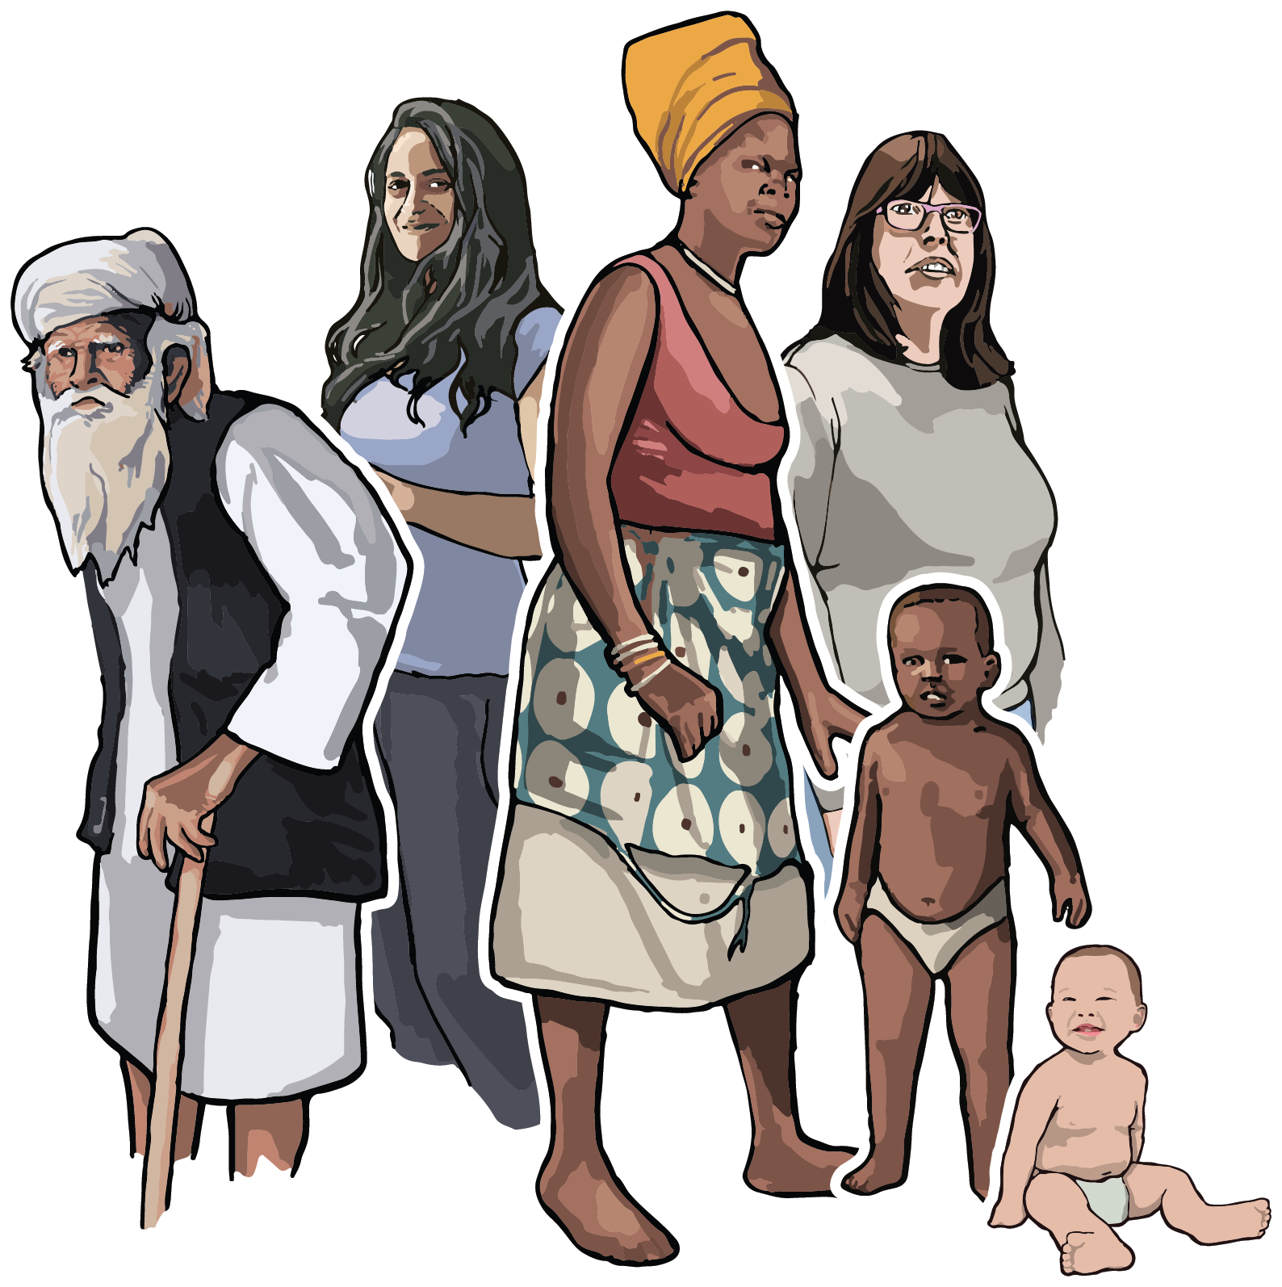




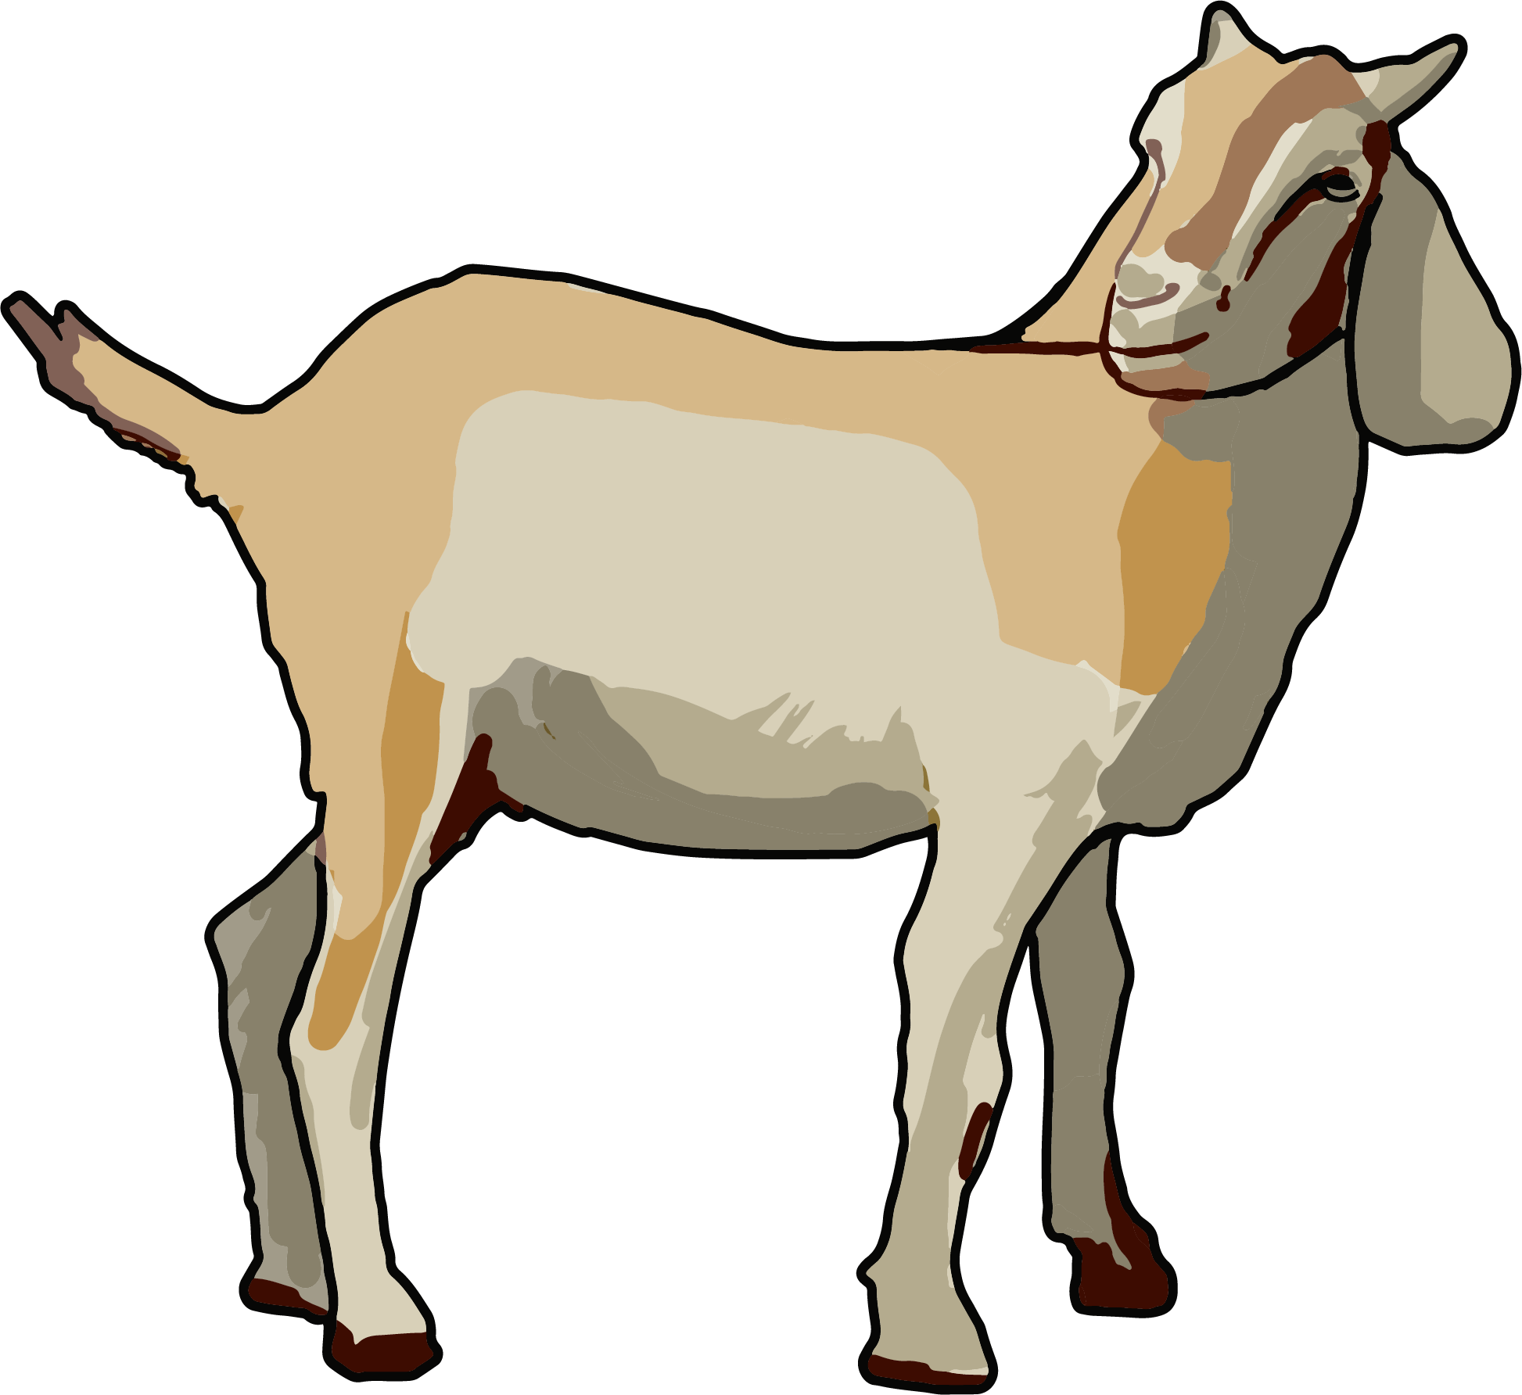
Data Lifecycle Management
Scientists and
Clinicians
Data Analysts
Biological Samples
BIOSTATISTICIANS AND DATABASE ADMINISTRATORS
Note: Images obtained from https://bioart.niaid.nih.gov/

Slide 9
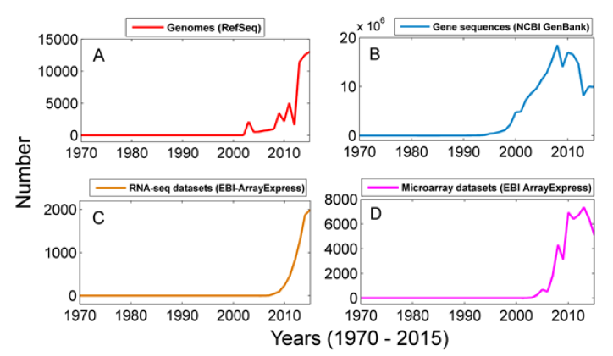
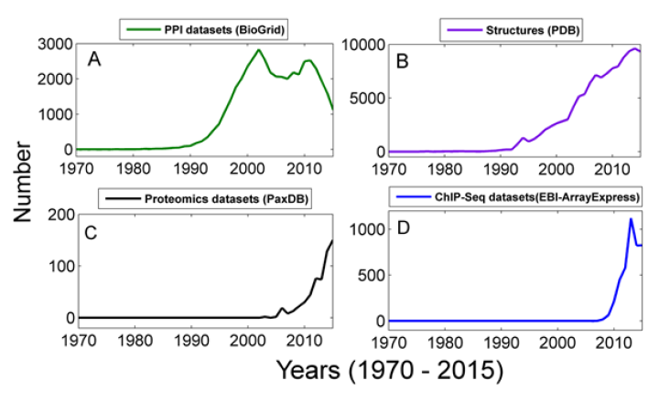
Data Lifecycle Management
Data Deluge
Increasing use of high throughput experimental techniques.
Generation of large amounts of diverse and heterogeneous biological data.
Challenges associated with the management, storage, and analysis of data.
Sarkar RR (2016) The Big Data Deluge in Biology: Challenges and Solutions. Global J Technol Optim 7: e103.

Slide 10
Data Lifecycle Management
What are the consequences of poor data management?
Decreased Reproducibility
Data Wastage
Cost
Need for standardized formats
→ Data Structures

Slide 11
Outline
Class Logistics
Introduction to Biological Data
Overview of Data Structures
Applications of Data Structures in Bioinformatics
Summary

Slide 12
Data Structures
An organization for a collection of data that ideally allows for fast access and certain operations on the data (O’Neil, 2019).
A method of storing information (either single item or some kind of composite item), and it is also characterized by the operations that can be performed on it (Machanick, 2019).
ORGANIZE
STORE
MANAGE
ANALYZE
1. O’Neil, S. T. (2019). A primer for computational biology. Pressbooks. https://open.oregonstate.education/computationalbiology/
2. Machanick, P (2019). Data Structures and Algorithms for Bioinformatics. RAMpage Research

Slide 13
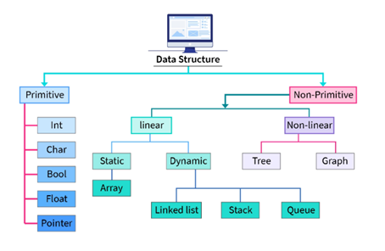
Data Structures
Primitive: Integer, Character, Boolean, and Floats.
Non-Primitive: Linear, Non-Linear, and Other.
Classification of Data Structures (https://findtodaysnotes.wordpress.com/classification-of-data-structures/)

Slide 14
Outline
Class Logistics
Introduction to Biological Data
Overview of Data Structures
Applications of Data Structures in Bioinformatics
Summary and Quiz

Slide 15
Data Structures in Bioinformatics
Enable the efficient storage, organization, management, and analysis of large-scale biological data.
Applications:
Genomic Sequence Analysis
Genome Assembly
Biological Network Analysis
Structural Bioinformatics
Phylogenetic Analysis
Data Integration and Mining
Gene Expression Analysis and NGS Data Processing
Review of commonly used data structures in bioinformatics

Slide 16
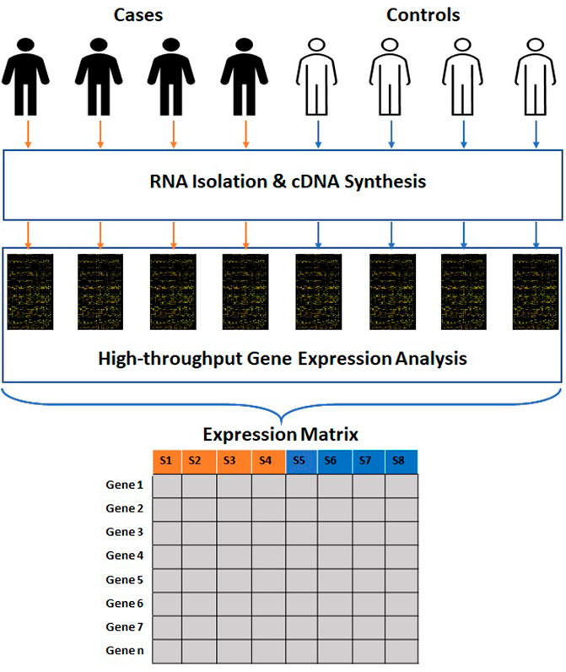
Data Structures in Bioinformatics
Arrays and Matrices
Store collections of elements of the same data type.
Vectors: One-dimensional arrays.
Matrices: Two-dimensional arrays.
Example Usage
Gene expression matrices
Bhandari, N., Walambe, R., Kotecha, K., & Khare, S. P. (2022). A comprehensive survey on computational learning methods for analysis of gene expression data. Frontiers in Molecular Biosciences, 9.

Slide 17
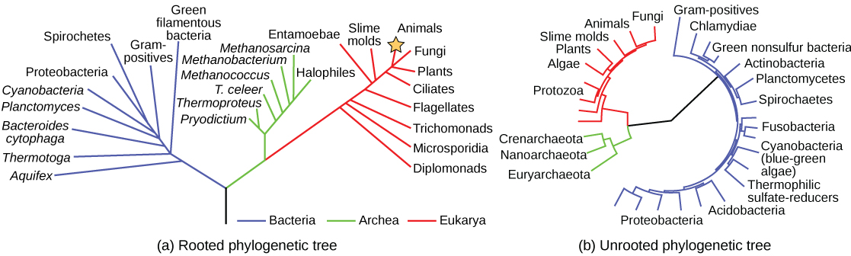
Data Structures in Bioinformatics
Trees
Hierarchical structures with a root (parent) node and child nodes.
Example Usage
Phylogenetic Trees
Limeri, L., & Reid, J. (2023, January 11). Introductory Biology 2. Pressbooks. https://raider.pressbooks.pub/biology2/

Slide 18
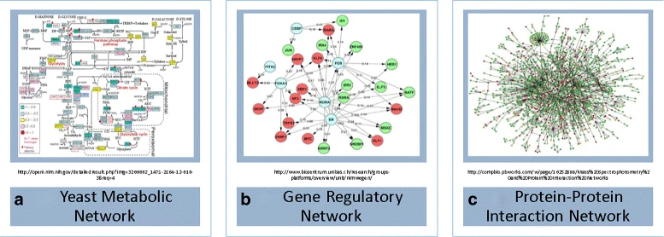
Data Structures in Bioinformatics
Graphs
Network of nodes connected to each other via edges.
Nodes contain data fields.
Edges act as an interaction between data fields.
Example Usage
Metabolic Network
Gene Regulatory Network
Protein-Protein Interaction
Network
Kim, W., Haukap, L. NemoProfile as an efficient approach to network motif analysis with instance collection. BMC Bioinformatics 18 (Suppl 12), 423 (2017).

Slide 19
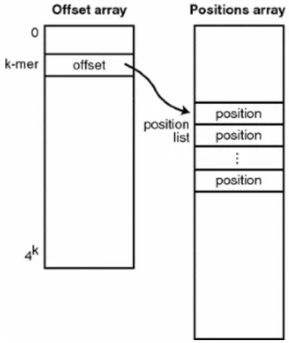
Data Structures in Bioinformatics
Hash Tables
Store key-value pairs.
Uses hash function to map keys to indices in an array.
Enables fast look up of values based on their keys.
Example Usage
Genome indexing (Wu, 2016)
Wu, T.D. Bitpacking techniques for indexing genomes: I. Hash tables. Algorithms Mol Biol 11, 5 (2016).

Slide 20
Data Structures in Bioinformatics
Linked Lists
Lists can store elements of different types.
Linked lists are linear data structures where elements are stored in nodes. Each node contains data and a pointer to the next node.
Example Usage
Sequence Alignment and Genome Assembly
Cyclic Metabolic Pathways (Krebs or Calvin)
Pathways of Metabolism | British Society for Cell Biology. (n.d.-b). https://bscb.org/learning-resources/softcell-e-learning/pathways-of-metabolism/

Slide 21
Data Structures in Bioinformatics
Stacks and Queues
Linear and dynamic data structures that are used for ordering operations on data.
Stacks: Last In, First Out.
Queues: First In, First Out.
Example Usage
Stacks: Backtracking algorithms for aligning biological sequences.
Queues: Parallel processing and managing bioinformatics pipelines.
Hendrix, D. A. (2019, October 3). Applied Bioinformatics. Pressbooks. https://open.oregonstate.education/appliedbioinformatics/

Slide 22
Outline
Class Logistics
Introduction to Biological Data
Overview of Data Structures
Applications of Data Structures in Bioinformatics
Summary

Slide 23
Summary
Data Deluge: Exponential increase in the amount of biological data being generated.
2. Need for efficient methods to organize, manage, store, and
organize data.
3. Selecting the appropriate data structures enables the efficient
use of large-scale biological data.

Slide 24
Outline
Class Logistics
Introduction to Biological Data
Overview of Data Structures
Applications of Data Structures in Bioinformatics
Summary

Slide 25
References
Sarkar RR (2016) The Big Data Deluge in Biology: Challenges and Solutions. Global J Technol Optim 7: e103.
O’Neil, S. T. (2019). A primer for computational biology. Pressbooks. (https://open.oregonstate.education/computationalbiology/)
Machanick, P (2019). Data Structures and Algorithms for Bioinformatics. RAMpage Research.
Classification of Data Structures (https://findtodaysnotes.wordpress.com/classification-of-data-structures/)
Limeri, L., & Reid, J. (2023, January 11). Introductory Biology 2. Pressbooks. (https://raider.pressbooks.pub/biology2/)
Kim, W., Haukap, L. NemoProfile as an efficient approach to network motif analysis with instance collection. BMC Bioinformatics 18 (Suppl 12), 423 (2017).
Wu, T.D. Bitpacking techniques for indexing genomes: I. Hash tables. Algorithms Mol Biol 11, 5 (2016).
Pathways of Metabolism | British Society for Cell Biology. (n.d.-b). (https://bscb.org/learning-resources/softcell-e-learning/pathways-of-metabolism/)
Hendrix, D. A. (2019, October 3). Applied Bioinformatics. Pressbooks. (https://open.oregonstate.education/appliedbioinformatics/)

